Slide 1

The Unresolved Challenge of Septic Cardiomyopathy (SCM)
Afonso Almeida – 100114
João Moura – 103693
2

Slide 2
Introduction

Slide 3
Introduction – SCM
Septic cardiomyopathy (SCM) is a cardiac dysfunction that develops in patients with sepsis;
Characterised by impaired cardiovascular performance;
Occurs when host response to an infection becomes dysregulated.
2

Slide 4
Introduction – SCM
Its diagnosis remains a challenge, making early detection difficult and mortality rates higher;
Estimated to affect 40-70% of adult patients with sepsis;
Some studies have associated SCM with increased mortality, while others have not found evidence.
3

Slide 5
Introduction – Objectives
Develop a method to accurately diagnose SCM based on patients’ personal and medical information;
Identify relevant patterns to support early and reliable diagnosis;
Dataset containing 207 attributes from 100 patients.
4

Slide 6
Methodology

Slide 7
Features of interest
Defining the target – “OBITO”;
Features with highest correlation with the target:
“Recov”;
“Dias_ate_morte”;
“RecovTime”.
6

Slide 8
Categorical features
“SEXO” – binarization;
“Agent” – embedding vectors.
7

Slide 9
Missing values
4% of dataset consisted of missing values.
Table 1 – Percentage of missing values for the features with the highest percentage
Feature | % of missing values
Vrenais_padrão≥0,8 | 43
Vrenais_padrão<0,7 | 43
Indice_resistencia | 43
Arenais_Vmin | 43
Arenais_Vmax | 43
CD4_CD8 | 37
PVC | 22
8

Slide 10
Missing values
Methods to fill missing values:
Mean;
Median;
Regression;
Multiple Imputation by Chained Equations (MICE):
MICE with regressions;
MICE with decision trees.
9

Slide 11
Missing values
Constant values for “Dias_ate_morte” and “RecovTime”;
Logarithmic transformation.
10

Slide 12
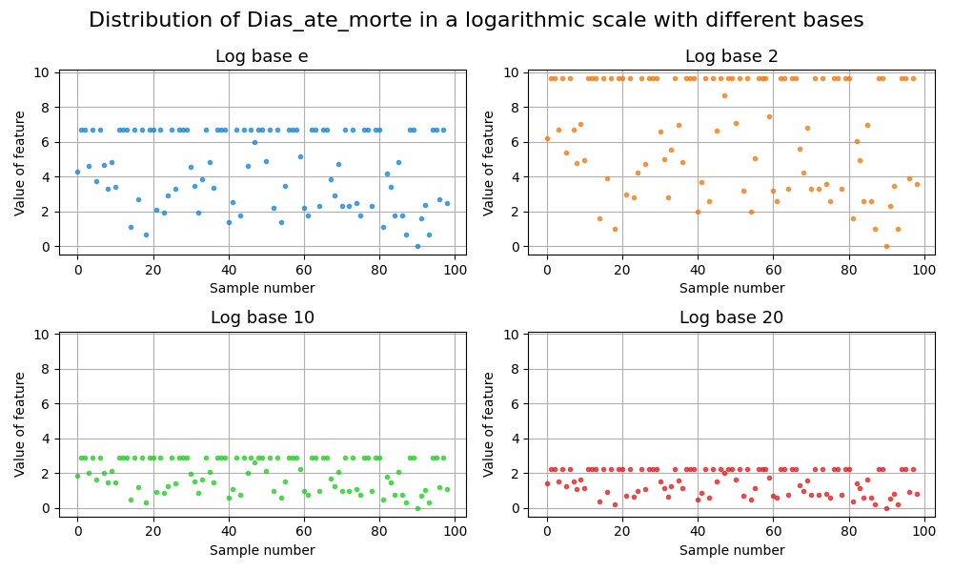
Missing values
Figure 1 – Distribution of Dias_ate_morte in a logarithmic scale with different bases
11

Slide 13
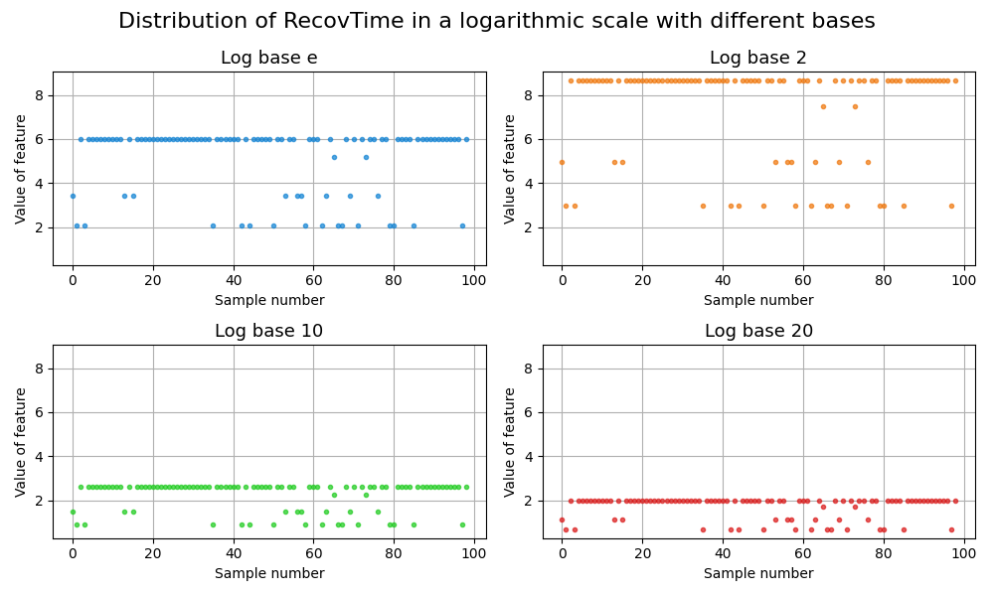
Missing values
Figure 2 – Distribution of RecovTime in a logarithmic scale with different bases
12

Slide 14
Feature selection
Correlation-based feature selection:
Correlation matrix;
Threshold = mean of correlations + k * standard deviation;
Tie-breaking criterion;
Principal Component Analysis (PCA):
20 principal components;
Cumulative Variance Explained (CEV).
13

Slide 15
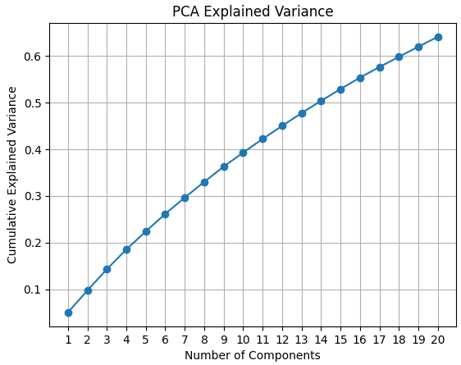
Feature selection
Figure 3 – Evolution of CEV over number of components selected
14

Slide 16
Final model
Splitting into training and validation (80%) and testing (20%) sets;
Fuzzy C-means clustering:
2 clusters;
Gaussian membership function.
15

Slide 17
Final model
Takagi-Sugeno (TSK):
Hybrid ANFIS training method:
Gradient descent for antecedent parameters;
Least squares for consequent parameters;
Leave-One-Out Cross-Validation:
Number of clusters (n=2);
Fuzziness parameter (m=2).
16

Slide 18
Results and discussion

Slide 19
Model performance – metrics
After hyperparameter tuning and training, the model was evaluated on the test set;
Final training phase restricted to small number of epochs.
Table 2 – Final performance metrics obtained
Accuracy | F1 Score | Recall | Precision
0.6500 | 0.6316 | 0.6667 | 0.6000
18

Slide 20
Model performance – Confusion matrix
Confusion matrix plotted for the test set;
In medical contexts, false negatives represent cases in which a patient is incorrectly classified as healthy.
19

Slide 21
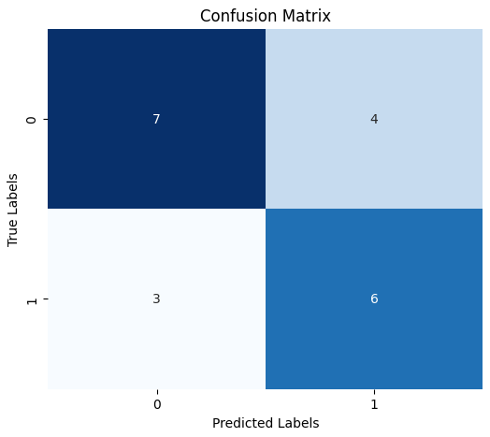
Model performance – Confusion matrix
Figure 4 – Confusion Matrix
20

Slide 22
Results interpretation
Results obtained were suboptimal, with model accuracy equal to 65%;
False negatives were least frequent error type;
Outputs of TSK model plotted with different colours to distinguish between correctly or incorrectly classified.
21

Slide 23
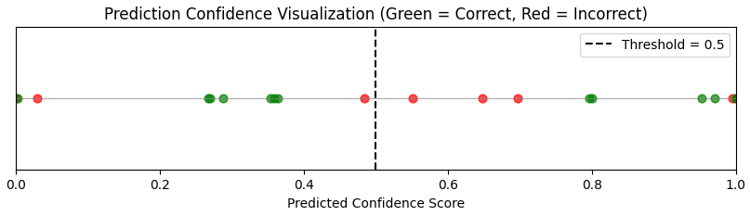
Results interpretation
Figure 5 – Prediction confidence scores
22

Slide 24
Results interpretation
Real-world medical dataset characterised by complex, highly independent variables and relatively low variance among samples;
Difficulty of identification of boundaries between classes reflected in low clustering performance (clustering score of 0.3333).
23

Slide 25
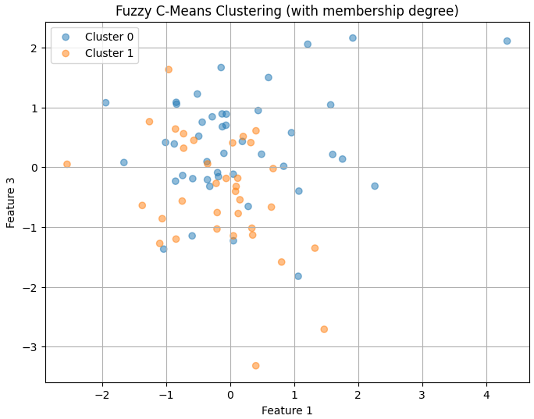
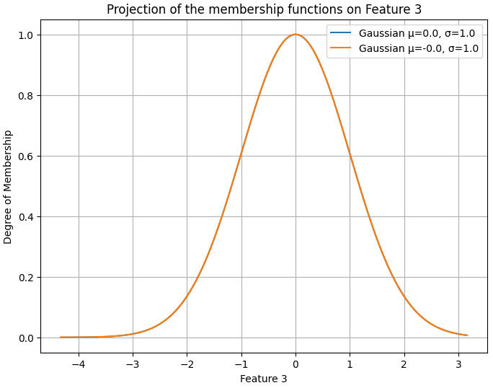
Results interpretation
Figure 6 – Clustering results (plotted on two features)
Figure 7 – Overlapping membership functions for one of the features
24

Slide 26
Conclusion

Slide 27
Conclusion
Application of TSK model with accuracy of 65%;
Struggle to capture the underlying patterns in the data, showed by incorrect predictions made with high confidence;
Limited ability to generalise, due to small sample size and low variance.
26

Slide 28
Future Work
This project is to be carried out as the master’s thesis of one of the group’s members.
Future work would include better handling and understanding of the data, and implementation of other methods to effectively train and test on the very few samples available.

